Slide 1

Green Pace
Security Policy Presentation
Developer: Jacob Suich

Slide 2

OVERVIEW: DEFENSE IN DEPTH
Green Pace’s software security policy follows a defense-in-depth strategy. This approach layers multiple security mechanisms to reduce the attack surface and prevent exploitation. As the development team grows, this policy provides clear, repeatable standards to ensure consistent, secure coding practices across all applications.

Slide 3
THREATS MATRIX
Common threats include buffer overflows, memory leaks, SQL injection, and unsafe input handling. These can be mitigated early using automated tools like Cppcheck, Clang-Tidy, and SonarQube in the build pipeline.
Likely Uninitialized variables (STD-002) Unsafe strings (STD-003) Input validation gaps (STD-008) Memory mismanagement (STD-005) | Priority Input validation (STD-008) and memory protection (STD-005) are highest priority due to exploitability and impact. Concurrency (STD-010) and file handling (STD-009) also require consistent attention.
Low priority Misused assertions (STD-006) have low severity and cost. Compiler often catches these; manual audits still needed. | Unlikely Data type misuse (STD-001) and assertion errors (STD-006) are uncommon due to compiler support and modern dev tools, but still worth addressing.

Slide 4
10 PRINCIPLES
Validate Input Data → STD-001, STD-002, STD-003, STD-004, STD-008
Heed Compiler Warnings → STD-001
Architect for Security → STD-004, STD-005, STD-007, STD-010
Keep It Simple → STD-006
Default Deny → STD-008, STD-009
Least Privilege → STD-009
Sanitize Outbound Data → STD-003, STD-004, STD-008, STD-009
Practice Defense in Depth → STD-005, STD-010
Use Effective QA Techniques → Applies to all standards (STD-001 to STD-010)
Adopt Secure Coding Standards → Applies to all standards (STD-001 to STD-010)

Slide 5
CODING STANDARDS
STD-005 – Memory Protection Critical for preventing buffer overflows, use-after-free, and memory leaks. High severity and high likelihood.
STD-008 – Input Validation Directly defends against injection attacks and logic corruption. Frequently exploited and high impact.
STD-004 – SQL Injection A common attack vector with major data breach potential. Moderate likelihood, but severe consequence.
STD-003 – String Correctness Poor handling of raw strings often causes overflows. Frequently observed in legacy code.
STD-010 – Concurrency Safety Race conditions and deadlocks affect reliability and are hard to detect manually.
STD-009 – Secure File Handling Protects against unauthorized access and file manipulation. Important for access control integrity.
STD-002 – Data Initialization Uninitialized variables can lead to unpredictable behavior and security risks.
STD-007 – Exception Handling Essential for stability and secure error propagation.
STD-001 – Data Type Safety Prevents logic errors and hidden bugs due to type mismatch. Caught early by most compilers.
STD-006 – Assertions Low risk in production but still important to replace with proper error handling logic.
Ranking System: Standards were prioritized based on severity, likelihood of occurrence, and remediation cost using a 1–5 scale. Vulnerabilities that are easy to exploit and expensive to fix post-deployment were ranked highest (e.g., memory misuse, input validation).

Slide 6
ENCRYPTION POLICIES
Encryption in Flight All data transmitted between clients, servers, and third-party services must use TLS 1.3. This protects against eavesdropping, tampering, and man-in-the-middle attacks during network communication.
Encryption at Rest Sensitive data stored on local drives or databases is encrypted using AES-256. Full-disk encryption is mandated for all devices handling protected or customer data.
Encryption in Use While data is being actively processed, it is protected using secure memory handling techniques. For high-risk operations (e.g., financial calculations), hardware-level isolation such as Intel SGX enclaves may be used.

Slide 7
TRIPLE-A POLICIES
Authentication All systems require multi-factor authentication (MFA) for login, system access, and sensitive operations. This policy protects against unauthorized access and credential misuse.
Authorization Green Pace follows a Role-Based Access Control (RBAC) model. Users are granted the minimum level of access required for their role. Permissions are reviewed regularly and adjusted as roles change.
Accounting All user activity is logged, including logins, permission changes, file access, and database interactions. These logs are encrypted, securely stored, and reviewed periodically to ensure compliance and traceability.

Slide 8
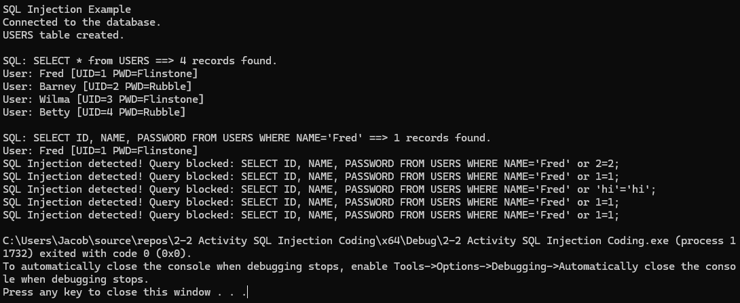
Unit Testing - Can SQL Injection Be Blocked?
Vulnerability Tested: SQL Injection (STD-004)
Test Type: Positive and negative inputs
Result Summary:
Safe input (e.g., 'Fred') executes successfully.
Malicious inputs (e.g., 'Fred' or 1=1) are detected and blocked.
Outcome: Query filtering and parameterized execution prevent exploitation.

Slide 9
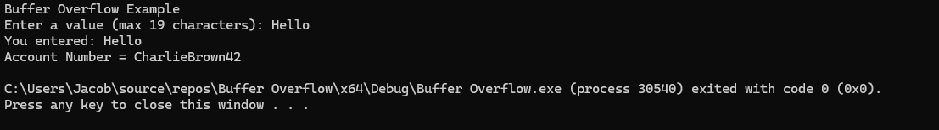
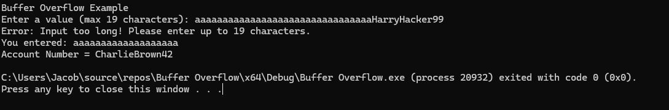
Unit Testing - Can Buffer Overflows Be Prevented?
Vulnerability Tested: Buffer Overflow (STD-005)
Test Type: Positive and negative inputs
Result Summary:
Input within the allowed length is accepted safely.
Excessively long input triggers an error and is rejected before overwriting memory.
Outcome: Manual bounds checking prevents memory corruption and protects static variables.

Slide 10
Unit Testing - Are Underflow and Overflow Detected Across Data Types?
Vulnerability Tested: Numeric Underflow & Overflow (STD-001, STD-002)
Test Type: Negative arithmetic scenarios across multiple data types
Result Summary:
Underflows detected in operations like 32767 - 6553 - 6
Overflows detected in operations like 2147483647 + 429496729
Proper detection messages shown for char, int, float, and unsigned types
Outcome: Boundary checks and overflow logic successfully identify unsafe numeric operations.

Slide 11
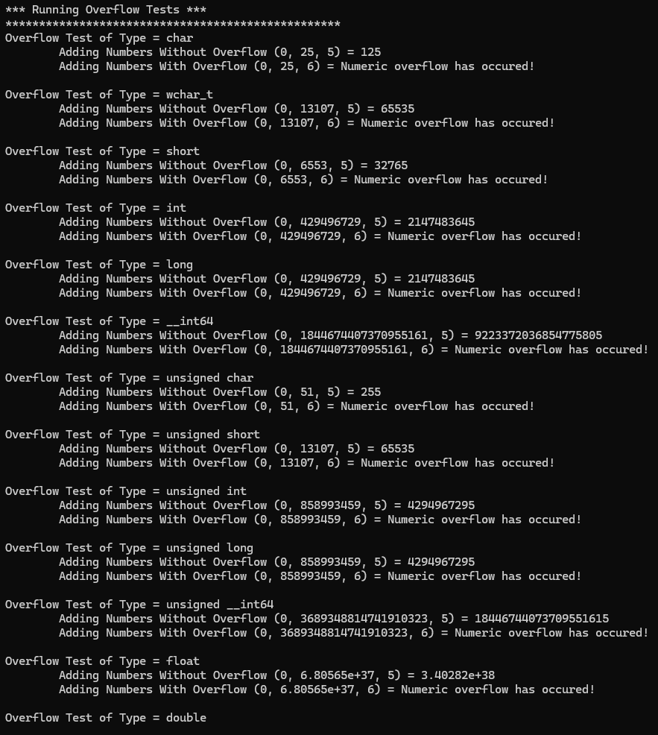
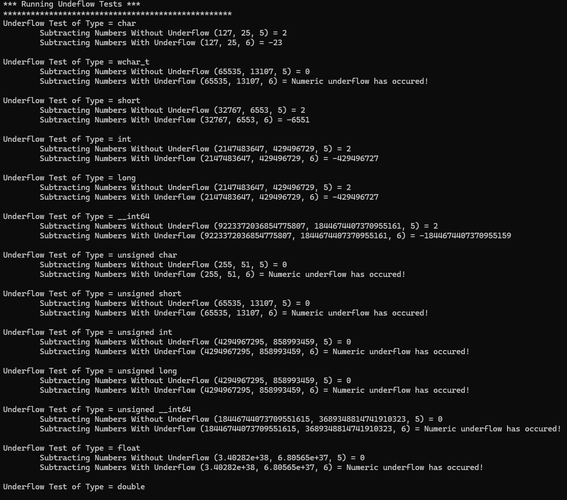
Underflow and Overflow cont.

Slide 12
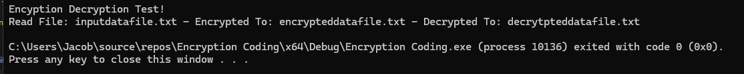
Unit Testing - Can File Data Be Encrypted and Decrypted Securely?
Vulnerability Tested: Improper encryption handling (STD-009)
Test Type: Positive test verifying encryption/decryption process
Result Summary:
Original file (inputdatafile.txt) is encrypted to encrypteddatafile.txt
Output is decrypted to decrypteddatafile.txt with no data loss
Outcome: The implementation confirms secure file I/O and proper key handling during encryption in use.

Slide 13
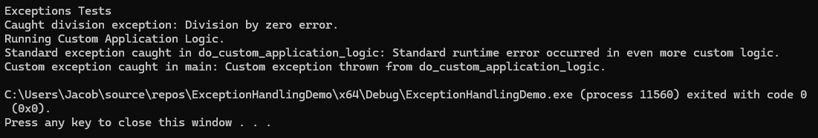
Unit Testing - Are Exceptions Caught and Handled Safely?
Vulnerability Tested: Improper exception handling (STD-007)
Test Type: Positive test for exception flow
Result Summary:
Division by zero triggers a standard exception and is caught successfully
Custom exception from business logic is thrown and handled without crashing the application
Outcome: Exception handling framework ensures graceful error recovery and prevents undefined behavior.

Slide 14

AUTOMATION SUMMARY

Slide 15
TOOLS
The DevSecOps diagram illustrates a continuous development cycle in the shape of an infinity loop, symbolizing constant iteration, improvement, and integration of security practices at every stage.
Plan & Assess Security policy and threat modeling integrated early during planning
Design & Build
Cppcheck and Clang-Tidy ensure compliance with SEI CERT C++ coding standards
Secure design patterns applied before implementation
Test & Validate
Google Test (GTest) for unit testing of vulnerabilities
SonarQube for static code analysis and quality gates
Visual Studio’s built-in tools for runtime and logic validation
Deploy & Monitor
CI/CD pipelines with pre-deployment scans
Logging, audit trails, and anomaly detection for ongoing security assurance

Slide 16
RISKS AND BENEFITS
Problems Identified
Vulnerabilities such as buffer overflows, SQL injection, and unchecked exceptions remain common in rapidly written or legacy C++ code.
Lack of automation early in the cycle increases the chance of late-stage detection and costly remediation.
Benefits of Acting Now
Reduces breach risk and liability through early detection and standardized practices.
Improves compliance with internal policies and external standards (e.g., SEI CERT, OWASP).
Enhances development team alignment and long-term code maintainability.
Risks of Waiting
Delayed adoption may lead to costly rework or system compromise.
Increased technical debt from insecure practices that compound over time.
Steps to Take
Fully implement all 10 coding standards immediately.
Automate enforcement across DevSecOps stages.
Educate all developers on secure patterns and policy updates.

Slide 17
RECOMMENDATIONS
Concurrency Oversight Current standards lightly address multithreading risks but lack comprehensive detection and mitigation strategies for race conditions and deadlocks.
Secure File Handling While encryption is enforced, there is limited policy coverage on file permission validation, safe file naming, and secure deletion practices.
Runtime Behavior Monitoring The policy lacks guidance on post-deployment anomaly detection or behavioral monitoring to detect malicious patterns or insider threats.
Policy Awareness & Enforcement No formal onboarding process exists to ensure all new developers are trained on security policy compliance from day one.

Slide 18
CONCLUSIONS
Concurrency Safety Frameworks Adopt thread-safe coding guidelines and integrate static analysis tools that detect data races and synchronization flaws (e.g., ThreadSanitizer).
File System Hardening Extend the policy to enforce strict file access controls, enforce naming conventions, and require secure file deletion protocols.
Behavioral Monitoring Integration Add standards for runtime behavior tracking, using anomaly detection to flag deviations from expected patterns.
Developer Security Onboarding Establish mandatory secure coding training for all new developers, paired with recurring policy refreshers.
Policy Evolution Mechanism Introduce a versioning system and a quarterly review process to continuously adapt the policy to emerging threats.

Slide 19
REFERENCES
SEI CERT. (n.d.). SEI CERT C++ Coding Standard: Rules for Developing Safe, Reliable, and Secure Systems. Software Engineering Institute, Carnegie Mellon University. Retrieved April 20, 2025, from https://wiki.sei.cmu.edu/confluence/pages/viewpage.action?pageId=88046682

